Slide 1
DATABASE MANAGEMENT SYSTEM PROJECT REVIEW
Department of Artificial Intelligence and Data Science
Academic Year: 2024 – 2025 (Even Semester)
Register Number : 2303811724322118
Name : VAISHALI A
Year : II
Semester : IV
Section : B
Date : 29-05-2025

Slide 2
Title of the Project
ONLINE EXAMINATION
SYSTEM

Slide 3
Problem Identified
1. Scalability Issues
As the number of users (students and administrators) grows, the system must handle high traffic loads, concurrent test-takers, and large-scale data storage without performance degradation.
2. Cheating Prevention
Online tests are vulnerable to malpractices such as multiple logins, screen sharing, external help, and AI-based cheating tools
3. Data Privacy & Security
Sensitive data, including student details, exam results, and authentication credentials, must be protected against cyber threats, data leaks, and unauthorized access.

Slide 4
Objective
The objective of the Online Examination System is to design and implement a secure, scalable, and user-friendly platform that facilitates the end-to-end process of conducting examinations digitally.
The system aims to automate exam creation, management, execution, evaluation, and reporting, thereby eliminating the inefficiencies and limitations of traditional paper-based exams.

Slide 5
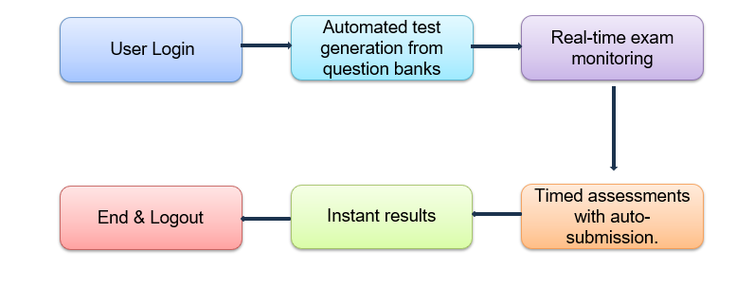
Proposed Architecture

Slide 6
Module List
Authentication Module
Test Creation & Management
Test Execution & Monitoring
Evaluation & Reporting
Feedback module

Slide 7
Module Implemented
Authentication Module:
This module handles user registration, login, logout, and role-based access control to ensure secure authentication for students, teachers, and admins. It manages password hashing, session management, and access restrictions to protect exam data and system integrity.
Key Methods:
login(username, password) — Authenticates user credentials and initiates a session.
logout(user_id) — Ends the user session securely.

Slide 8
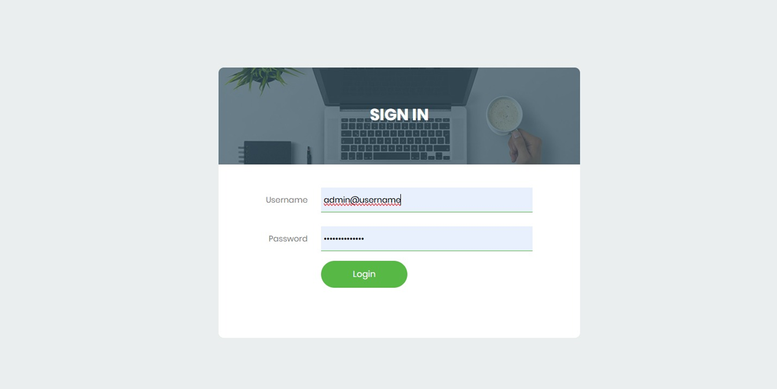
Module Implemented

Slide 9
Module Implemented
Dashboard
Displays the main navigation panel after login, giving access to all online exams system.
MANAGE COURSE
MANAGE EXAM
MANAGE EXAMINEE
RANKING
REPORTS
FEEDBACK

Slide 10
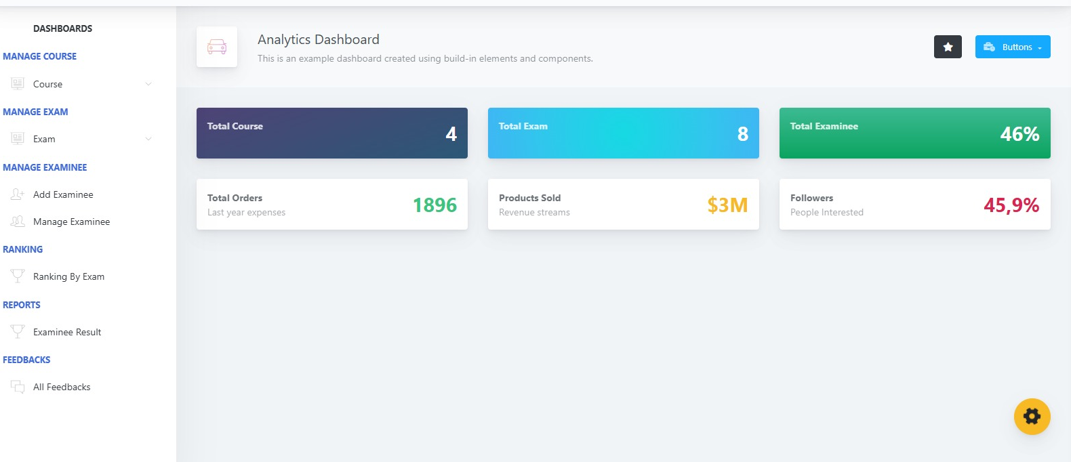
Module Implemented

Slide 11
Module Implemented
Test Creation & Management:
Allows teachers or admins to create, update, organize, and delete tests. Tests include metadata like title, description, duration, and question sets. Supports categorization and status control (draft, published).
Key Methods:
create_test(test_data) — Inserts a new test into the database.
update_test(test_id, updated_data) — Modifies existing test details.
add_question(test_id, question_data) — Adds questions to a test.

Slide 12
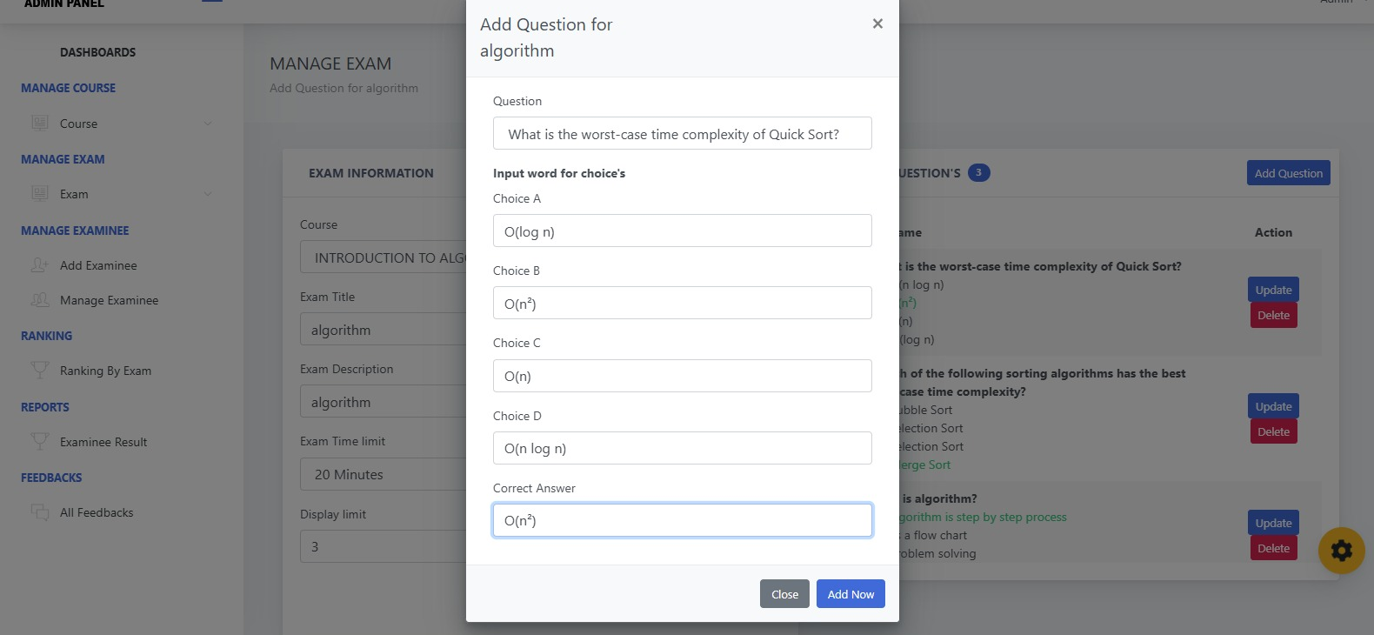
Module Implemented

Slide 13
Module Implemented
Test Execution & Monitoring:
Handles the student-facing test interface including timing, navigation between questions, answer submission, and real-time monitoring to prevent cheating (e.g., tab-switch detection).
Key Methods:
start_test(user_id, test_id) — Initializes a test session for the user.
submit_answer(session_id, question_id, answer) — Records the student's answer.
get_next_question(session_id) — Retrieves the next question for the student.
.

Slide 14
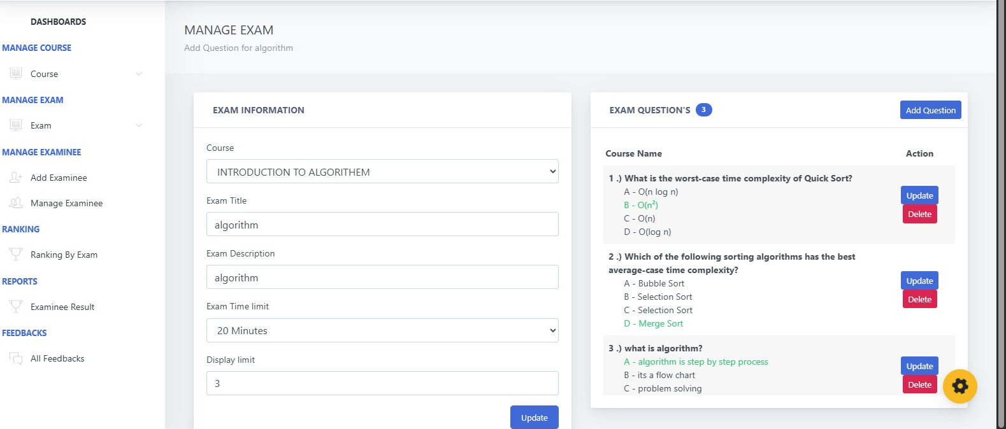
Module Implemented

Slide 15
Module Implemented
Evaluation & Reporting:
Automates scoring for objective questions, collects subjective answers for manual review, and generates comprehensive reports for students and instructors.
Key Methods:
auto_score(session_id) — Automatically scores multiple-choice questions.
generate_report(user_id, test_id) — Produces performance reports and analytics.

Slide 16
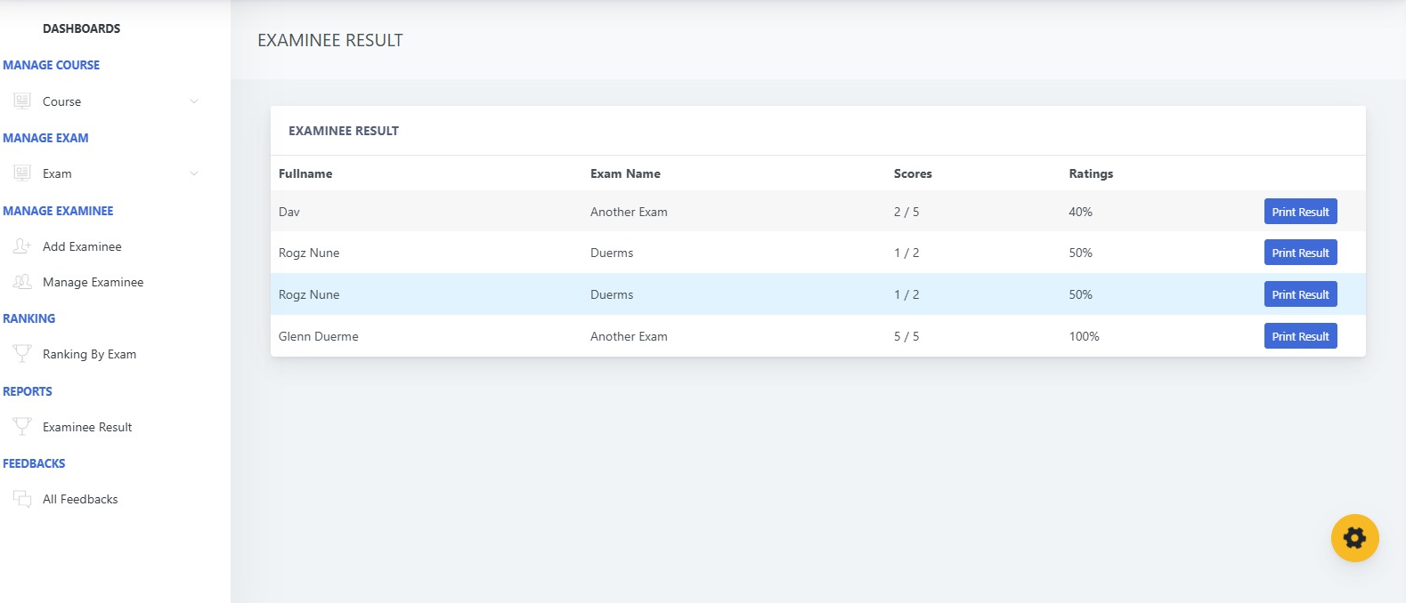
Module Implemented

Slide 17
Module Implemented
Feedback Module
Collects student feedback on tests and the system itself to improve the quality of exams and user experience.
Key Methods:
submit_feedback(user_id, test_id, feedback_text, rating) — Records feedback from users.
view_feedback(test_id) — Allows instructors to view feedback for specific tests.

Slide 18
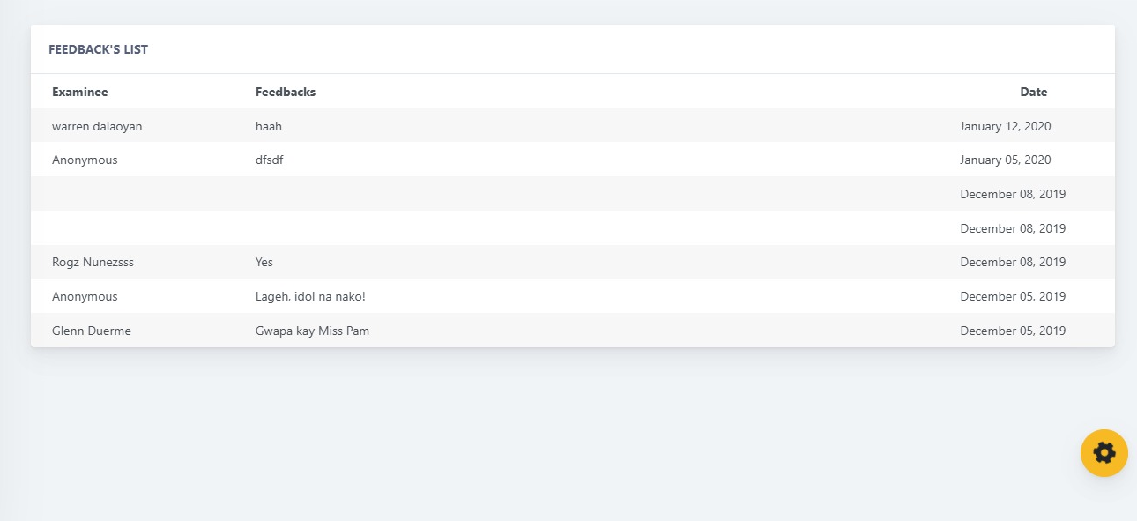
Module Implemented

Slide 19
Conclusion
Conclusion:
The Online Examination System provides a robust, user-friendly, and secure platform for managing the end-to-end process of conducting digital exams.
It is a modular architecture covering authentication, test creation, execution, evaluation, and feedback collection, the system effectively reduces manual overhead and improves exam accuracy and efficiency.
Future Scope:
AI-Based Proctoring
Advanced Analytics Dashboard
Mobile Application Support

Slide 20
Thank You
Any queries???

